Slide 1


ANIMAL
DETERRENCE
Using Computer Vision and Raspberry pi
Team Members
Guided by
Dr. Ch. Venkata Narayana
Professor
K. Vamsi
P. Pallavi
G. Dedeepya

Slide 2
FLOW OF PROPOSAL
ABSTRACT
INTRODUCTION
LITERATURE SURVEY
EXISTING SYSTEM
PROPOSED SYSTEM
REFERENCES

Slide 3
ABSTRACT
The goal of the work is to create an automated system for preventing unwanted animal invasions in restricted areas by employing computer vision algorithms and the computing power of the Raspberry Pi. Real-time video feeds are captured by cameras placed strategically across the monitored area, and these feeds are then analyzed to identify and categorize animals based on visual signals using Computer vision. The system starts deterrent devices like alarms, lights, or non-lethal deterrents when it detects an unauthorized animal presence. The success of the project hinges on precise computer vision models and effective Raspberry Pi-to-camera connection. Overall, work’s implications are broad, ranging from safeguarding agricultural yield to protecting wildlife habitats and maintaining urban green spaces. By combining the power of Raspberry Pi and computer vision, this system offers an innovative and humane approach to animal deterrence, mitigating human-animal conflicts and promoting coexistence in various environments.

Slide 4
INTRODUCTION
India is an agricultural country and it contributed 19.90 percent of GDP in 2020-21.
Human-animal conflict is a major challenge where an enormous amount of resources are lost and human life is in danger.
In recent times, the number of such incidences has been increasing.
Intrusion systems are mainly designed for the surveillance of Humans and rarely for intruding animals.
Between 2010 and 2020, India witnessed a significant loss of wildlife due to electrocution, with more than 1300 animals affected. This included over 500 elephants, 220 flamingos, 150 leopards, and 46 tigers.
In 2017, the state of Maharashtra recorded an alarming spike in tiger deaths, reaching 21, the highest number in the decade. Six of these tiger deaths were deliberate cases of electrocution, raising serious concerns.
Disturbingly, around 60% of elephant deaths in the region are attributed to electrocution, while some elephant calves also lose their lives due to getting trapped in trenches.
A concerning issue highlighted in a survey is the underreporting and neglect of wild animal fatality cases, with many going unattended for months, indicating a lack of responsiveness from the forest department.

Slide 5
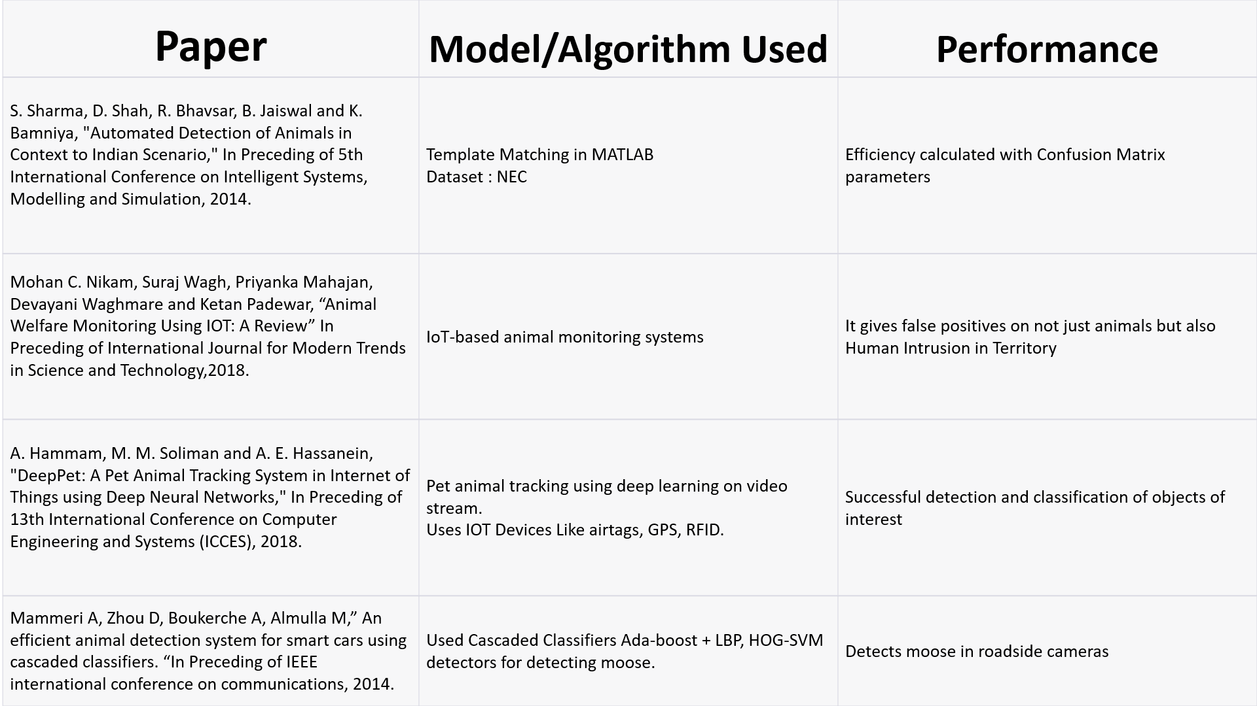
LITERATURE SURVEY

Slide 6
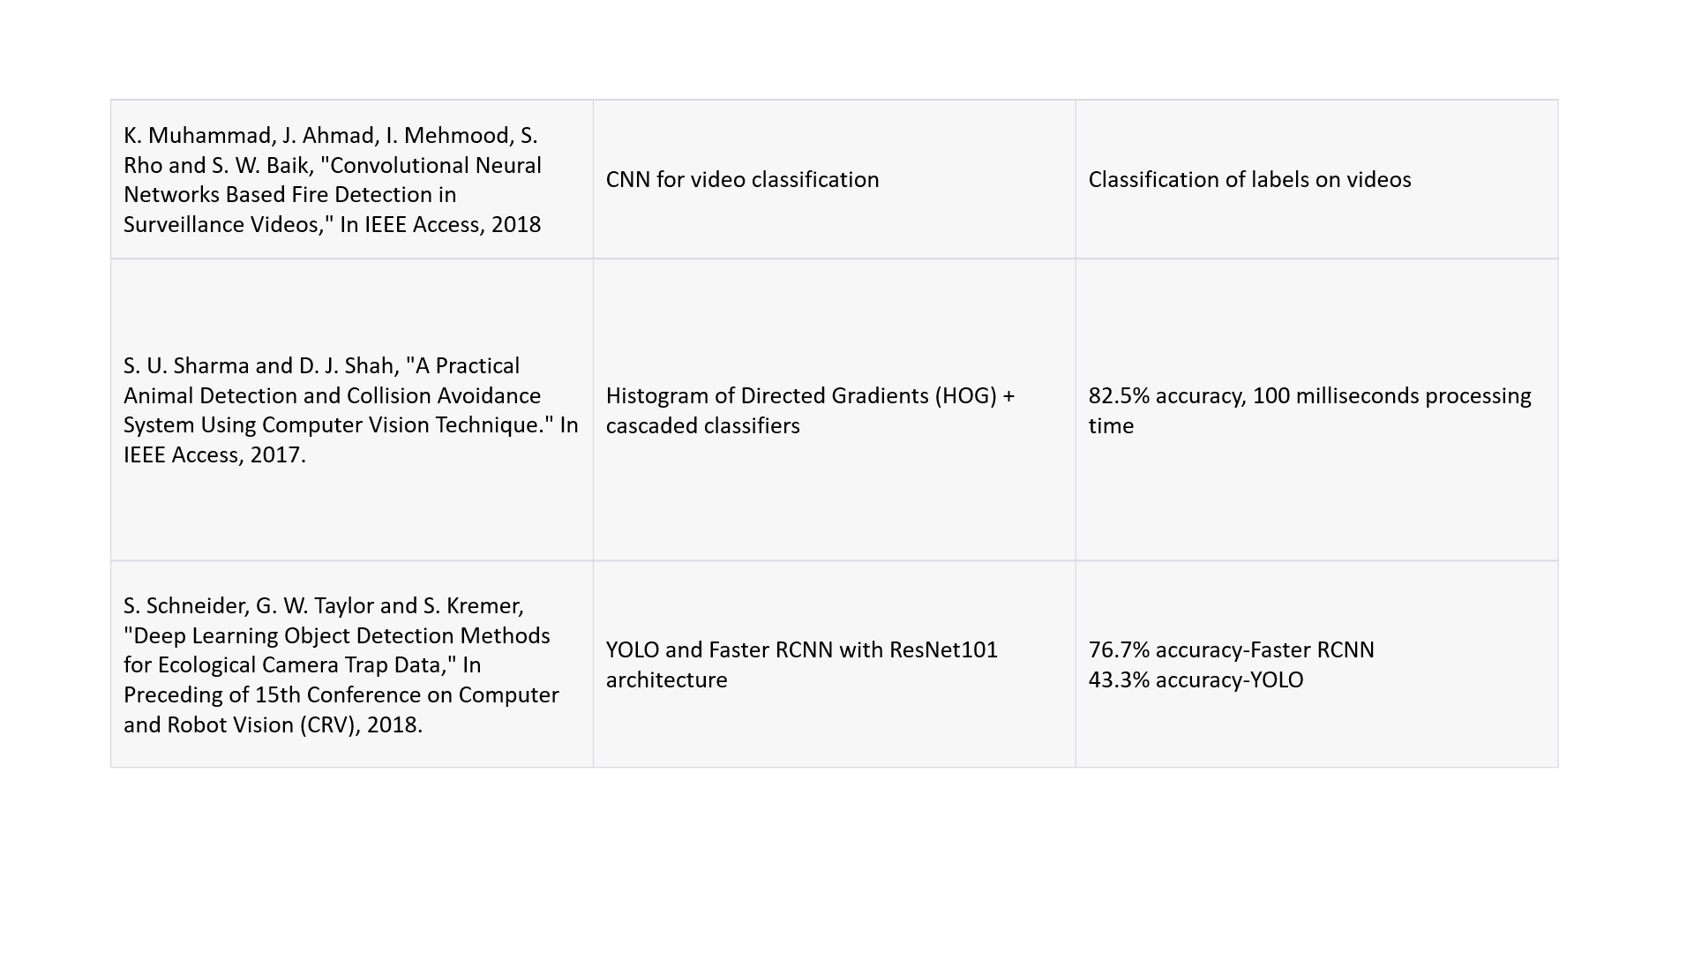
LITERATURE SURVEY

Slide 7
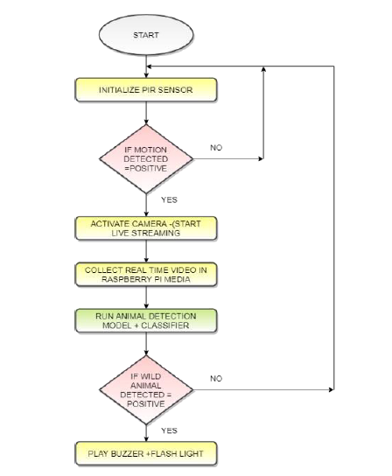
EXISTING SYSTEM
The whole system flow can be divided into three major parts.
1. Training Model with standard datasets (Microsoft COCO)used
2. Building Animal Detection model which works on real time video streaming.
In this system they using YoloV3 with Darknet Architecture.
Motivated by ResNet and FPN (Feature-Pyramid Network) architectures, YOLO-V3 uses a feature extractor is called Darknet-53.
3. Repelling the hazardous intruder (only wild animals if found) without harming it.
Flow chart Diagram for Existing System.

Slide 8
DRAWBACKS OF EXISTING SYSTEM
There are two major drawbacks of Existing System :
1. Dataset: Existing system used COCO(Common Object in Context) which is
standard dataset contains 80 categories and 330K object instances
2.Model:
Existing system using YoloV3 with Darknet Architecture. YOLO V3 is an improved version among the YOLO detection network family. In contrast to previous versions, it features multi-scalar detection, a stronger feature extractor network, and few modifications in the loss function.
Motivated by ResNet and FPN (Feature-Pyramid Network) architectures, YOLO-V3 uses a feature extractor is called Darknet-53. Each of these layers processes the image at a different spatial compression.

Slide 9
EXISTING SYSTEM DATASET DESCRIPTION
COCO Dataset
The COCO (Common Objects in Context) dataset is a large-scale object detection, segmentation, and captioning dataset. It is an essential dataset for researchers and developers working on object detection, segmentation, and pose estimation tasks.
Key Features
COCO contains 330K images, with 200K images having annotations for object detection, segmentation.
The dataset comprises 80 object categories, including common objects like cars, bicycles, and animals, as well as more specific categories such as umbrellas, handbags, and sports equipment.
Annotations include object bounding boxes, segmentation masks, and captions for each image.
COCO provides standardized evaluation metrics like mean Average Precision (mAP) for object detection and mean Average Recall (mAR) for segmentation tasks, making it suitable for comparing model performance.

Slide 10
COCO DATASET-DRAWBACKS
Imbalance Across Categories: Some object categories in COCO have more instances than others. This class imbalance can lead models to perform better in over-represented categories and struggle with less frequent ones
Limited Scene Diversity: While COCO covers a range of scenes, it may not capture the full diversity of real-world scenarios. Models trained on COCO may not generalize well to highly specific or unusual environments.
Annotation Quality: While COCO annotations are generally of high quality, there may be cases of annotation errors or inconsistencies. Such errors can impact the training and evaluation of models.
Noisy Captions: COCO includes image captions, but the quality and relevance of captions can vary. Some captions may not accurately describe the content of the image, introducing noise in tasks that use the captioning aspect of the dataset.
Limited Context Information: Despite being called "Common Objects in Context," the contextual information in COCO might not be rich enough for certain tasks. More complex contextual relationships between objects may be required for certain applications

Slide 11
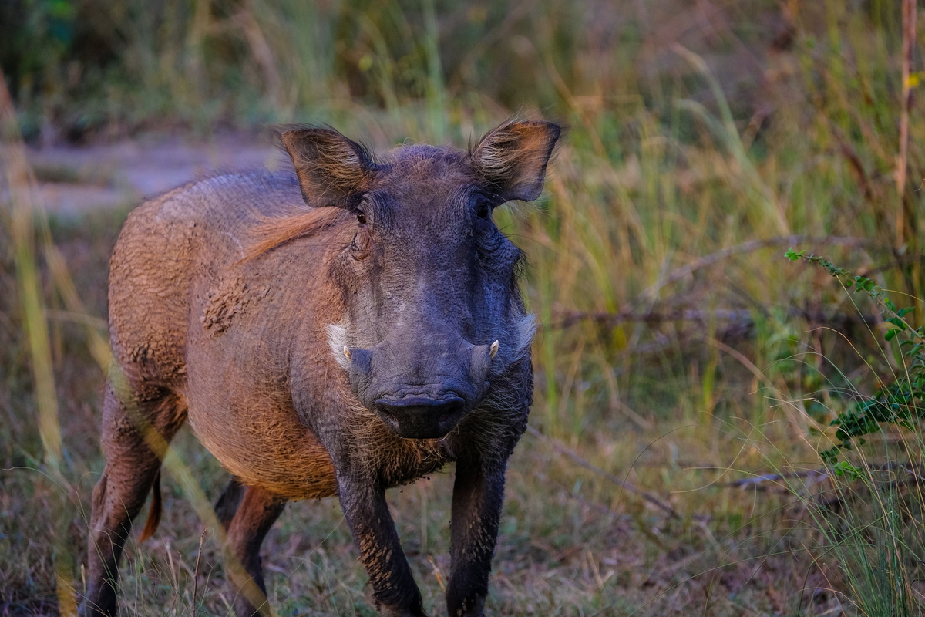
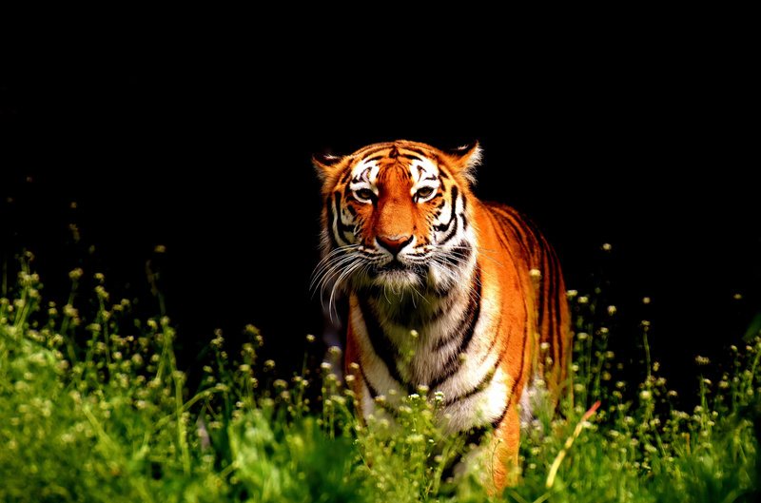
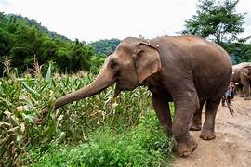
PROPOSED SYSTEM -METHODOLOGY
STEP 1:DATA PREPARATION
Preparing a dataset for a computer vision model is a crucial step in training an effective model.
Here are the steps you should follow to prepare your dataset :
1.1.Data Collection
Gather a diverse animal images like elephant, tiger, Pig,Leapord.
we had ensured that images are of good quality, well-lit, and free from artifacts or distortions.
Organize your images into a clear folder structure,
Dataset structure
Dataset folder
|-----train------images, labels
|------test-----images, labels
|------valid----images, labels

Slide 12
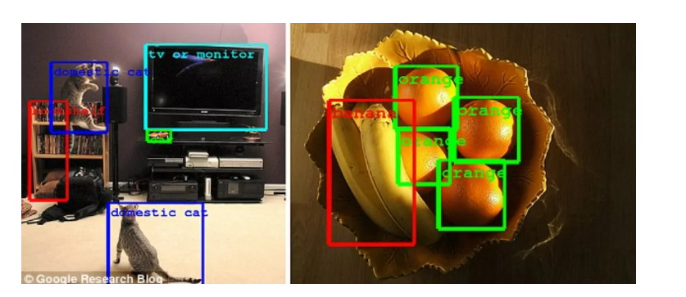
PROPOSED SYSTEM
1.2.Data Annotation
Image annotation is one of the most important stages in the development of computer vision and image recognition applications, which involves recognizing, obtaining, describing, and interpreting results from digital images or videos.
Image annotation
There are five main techniques of image annotation,
1.Bounding box:
2.Landmarking
3.Masking
4.Polygon
5.Polyline

Slide 13
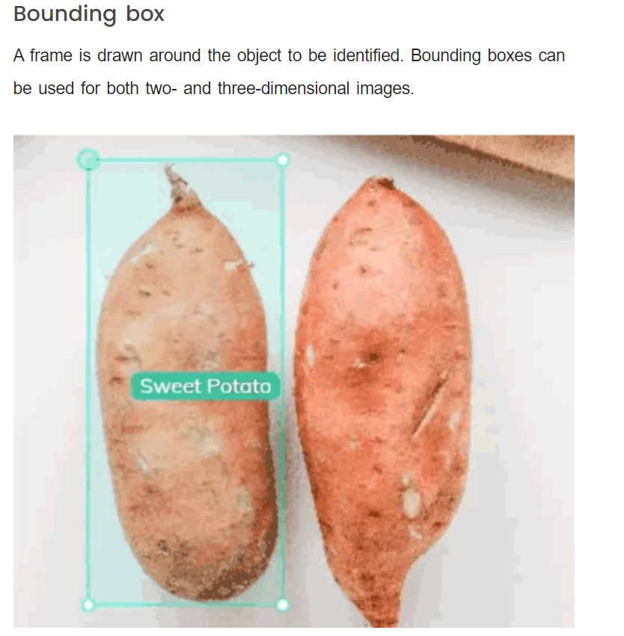
PROPOSED SYSTEM
IMAGE ANNOTATION TECHNIQUES
Technique 1: BOUNDING BOXES
A frame is drawn around the object to be identified. Bounding boxes can be used for both two or three dimensional images

Slide 14
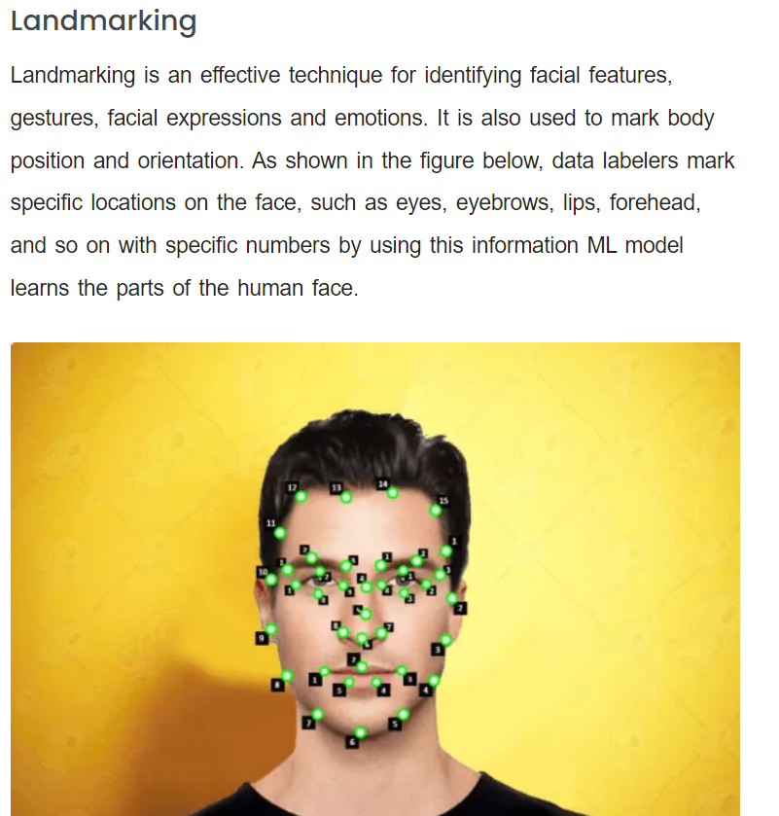
Technique 2: LANDMARKING
Landmarking is an effective technique for identifying facial features, gestures, facial expressions and emotions .It is also used to mark body position and orientation . As shown in figure below, data labelers mark specific locations on the face ,such as eyes, eyebrows ,lips, forehead and so on with specific numbers by using this information ML model learns the parts of the human face

Slide 15
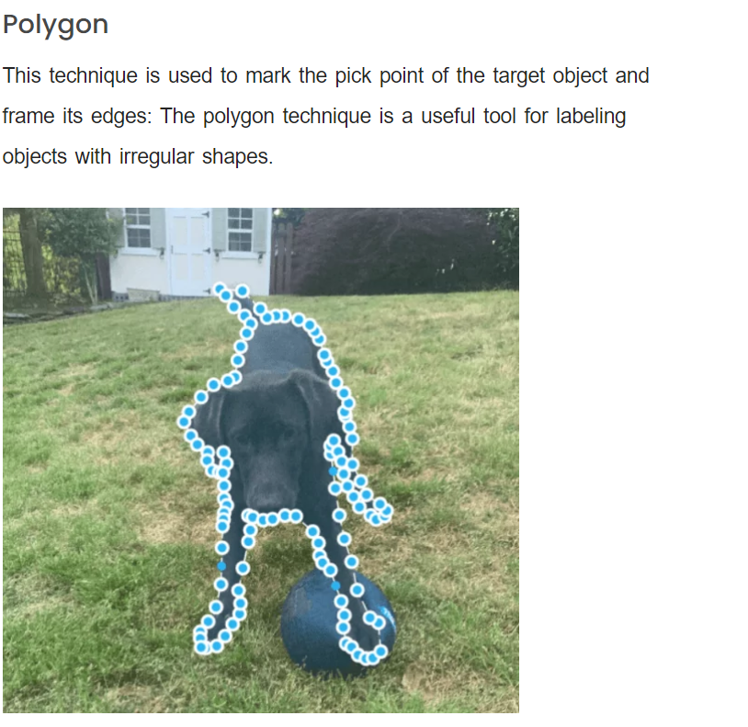
Technique 3: Polygon
This technique is used to mark the pick point of the target object and frame its edges. This polygon technique is useful tool for labelling objects with irregular shapes

Slide 16
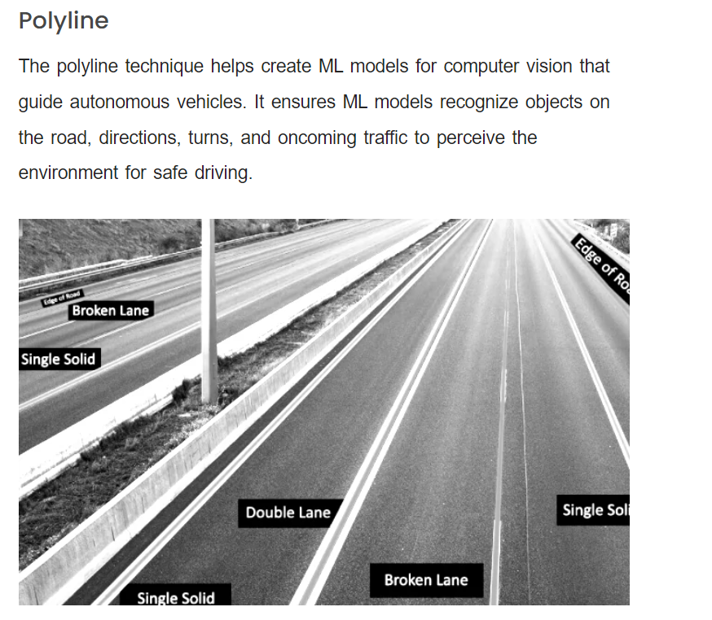
Technique 4: Polyline
This technique helps create ML models for computer vision that guide autonomous vehicles .It ensures ML models recognize objects on the road ,directions, turn and oncoming traffic to perceive the environment for safe.

Slide 17
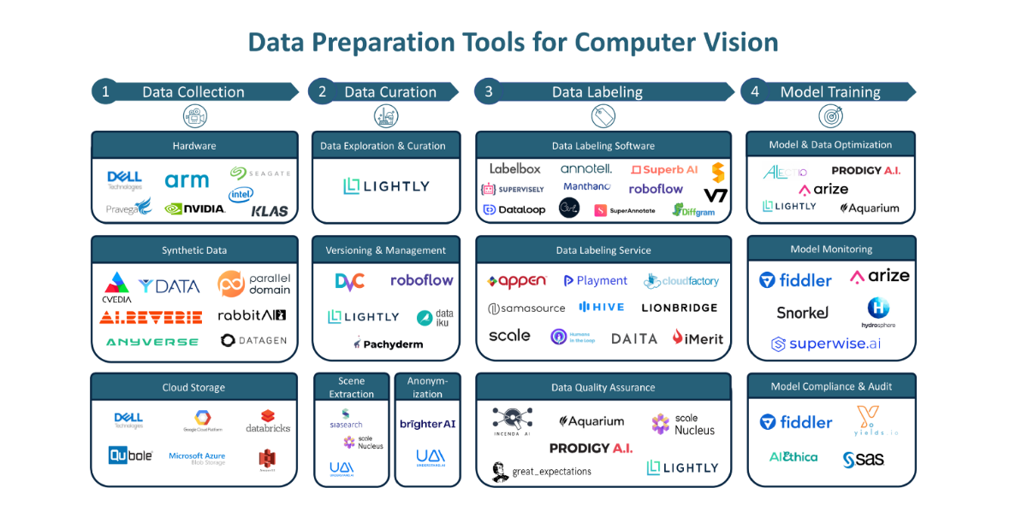
TOOLS USED FOR DATA PREPARATION
Because of advancement of AI ,so many data preparation tools are emerging day by day. In order to save time and reduce the tedius task of manual data preparation,We had used the software called “Roboflow” for our datapreparation tasks like data annotation,data labelling etc.
Roboflow is a opensource software which is used to make you computer vision tasks easy

Slide 18
PROPOSED SYSTEM
1.3 Data Preprocessing
Resize all images to a uniform size. Common sizes are 224x224, 256x256, or 512x512,depending on your model architecture. we used 640x640
Normalize the pixel values, typically by scaling them to the range [0, 1] or [-1, 1].
Augment your dataset with data augmentation techniques like rotation, translation, scaling, flipping, or color adjustments to increase model robustness..

Slide 19
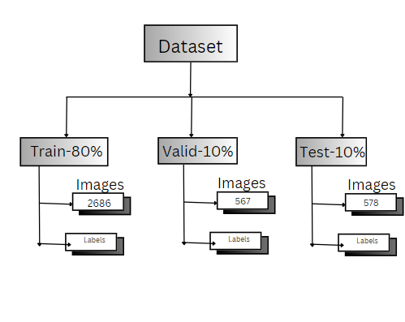
1.4 Data Split

Slide 20
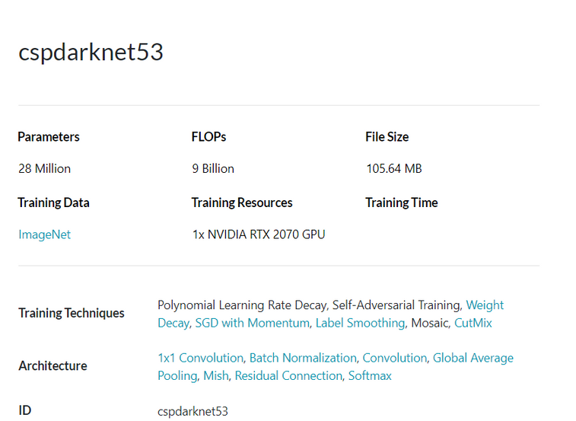
PROPOSED SYSTEM
1. Dataset: This system uses custom dataset called animal dataset which contains 4 categories namely Elephant ,tiger, pig and leapord and 3831object instances
2.Model:
Proposed system uses YOLO v8 with the efficient back bone architecture called CSP darknet architecture which is much more efficient in terms of speed and accuracy

Slide 21
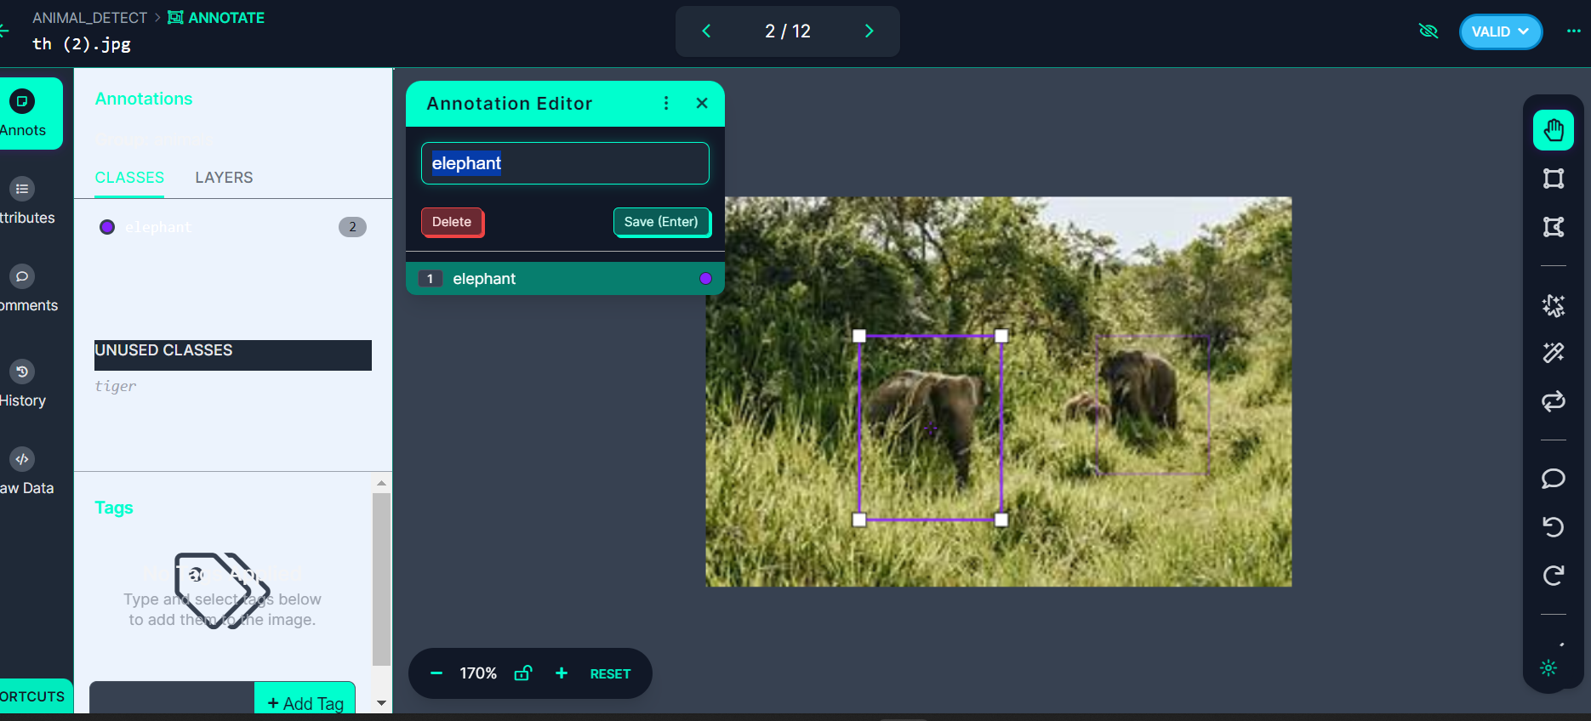
SNAPSHOTS OF DATASET

Slide 22
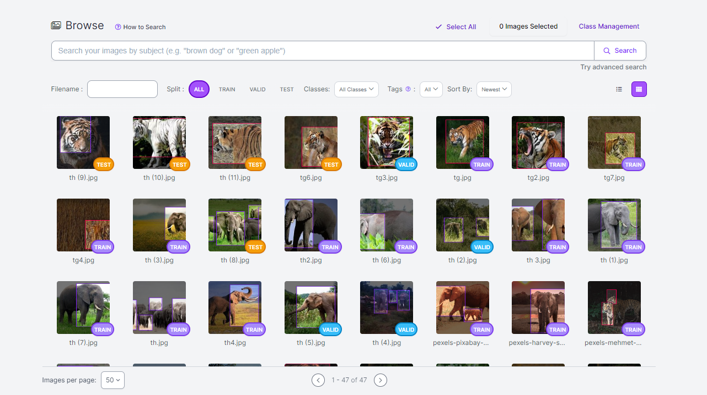

Slide 23
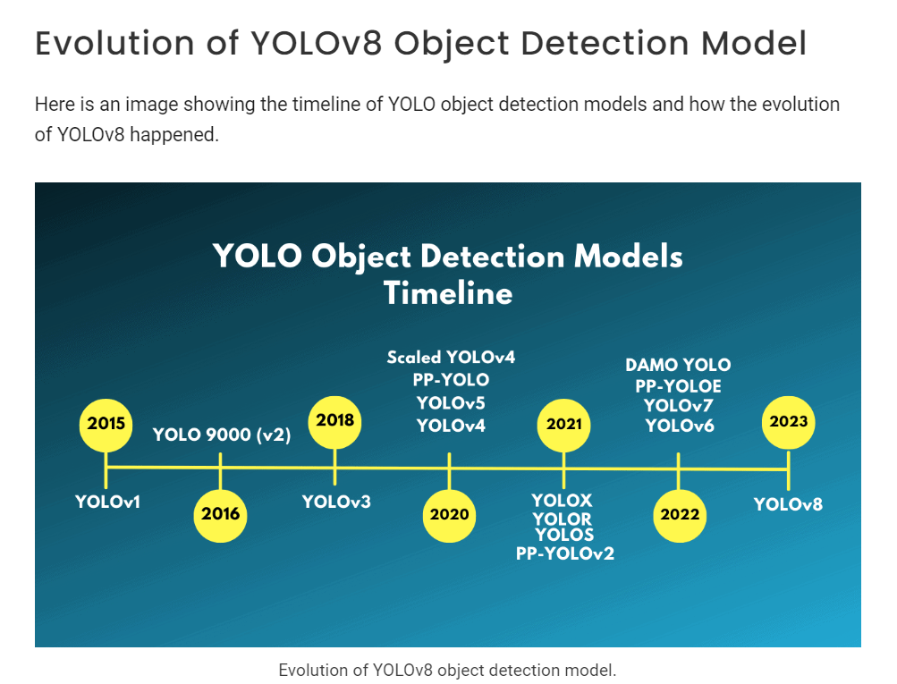
PROPOSED MODEL HISTORY

Slide 24
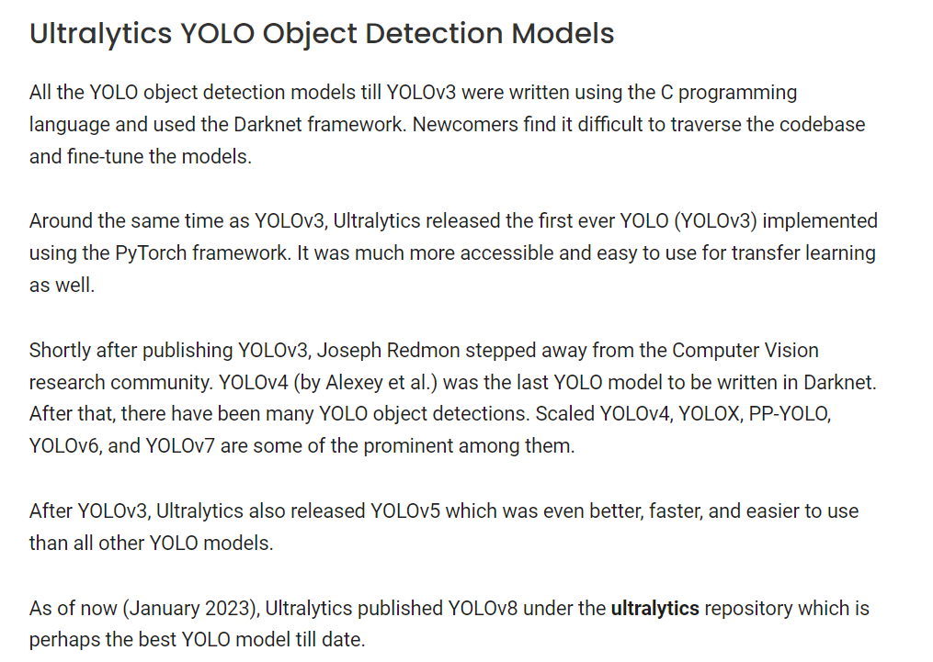
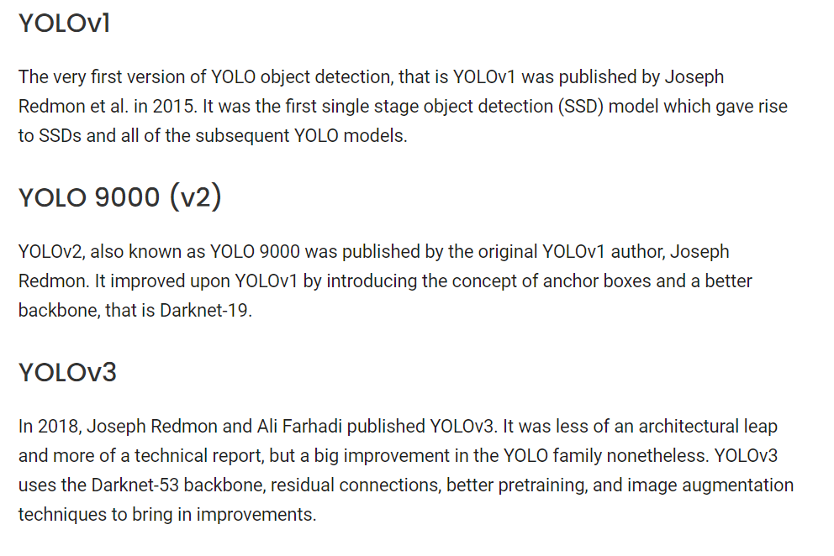
PROPOSED MODEL HISTORY

Slide 25
MODEL ARCHITECTURE
YOLO: A STATE-OF-THE-ART OBJECT DETECTION ALGORITHM
Joseph Redmon et al. introduced the YOLO (You Only Look Once) algorithm for real-time object detection in 2016.
The YOLO algorithm utilizes a single neural network for predicting the class probabilities and bounding boxes of objects in an image.
Traditional object recognition algorithms have multiple steps to find objects, but YOLO only has one step to process the whole picture. This makes it faster and more efficient.
The YOLO algorithm also uses anchor boxes to improve detection accuracy and handle objects of different sizes and aspect ratios.
YOLOv8, which forms the latest version of the algorithm, is the fastest and most accurate YOLO model to date, which achieves state-of-the-art evaluations on several benchmark datasets.

Slide 26
MODEL ARCHITECTURE
Variants of YOLO v8:
1. YOLO v8-Tiny: YOLO v8-Tiny makes a trade-off between accuracy and prediction speed. It achieves this by adopting a small network architecture and small grid size (eg, 13x13), enabling real-time performance even on resource-constrained devices.
2. YOLO v8-SPP: Spatial Pyramid Pooling (SPP) type of YOLO v8 includes an SPP module in the network. This addition facilitates the effective capture of multi-scale features, leading to improved accuracy, especially for objects of different sizes.
3. YOLO v8-CSPDarknet: YOLO v8-CSPDarknet is a marriage of YOLO v8 architecture with CSPDarknet backbone. This fusion results in superior performance and accuracy. The inclusion of a CSP (cross-stage partial) connection boosts the representation feature, making it an ideal choice for a variety of applications.
4. YOLO v8-Panet: YOLO v8-Panet integrates the PANET (Path Aggregation Network) architecture, which enhances the accuracy of feature fusion and object detection. This version is best in scenarios where precise object localization is paramount.

Slide 27
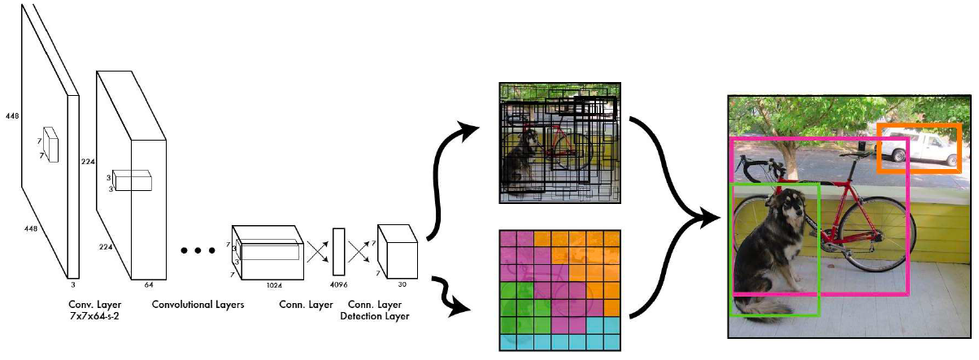
YOLO ARCHITECTURE

Slide 28
Differences between YOLOv3 and YOLOv8(Backbone Architecture)
The major difference between the YOLOv3 and YOLOv8 is its backbone architecture
Speed and accuracy.
Darknet-53(YOLOv3):
Backbone architecture used in YOLOv3 is Darknet architecture.
Consists of 53 convolutional layers.
Based on the Darknet architecture, it is a variant of ResNet.
Relatively simple and lightweight compared to more advanced architectures.
Performs well in feature extraction tasks, enabling effective object detection.

Slide 29
CSPDarknet53 (YOLOv8):
Enhanced version of Darknet-53 used in YOLOv4 (and YOLOv8).
Introduces cross-stage connections for improved information flow.
Splits feature maps into two parts, processes one part locally, then recombines them.
Incorporates optimization techniques like channel shuffle and route aggregation.
Generally outperforms Darknet-53 in terms of accuracy and efficiency due to its improved architecture and optimization techniques.
Supports a broad spectrum of vision AI tasks, including detection, segmentation, pose estimation, tracking, and classification, making it suitable for diverse applications.
It Allows seamless deployment across various hardware platforms, from edge devices to cloud-based APIs, ensuring adaptability and performance optimization for different environments.

Slide 30
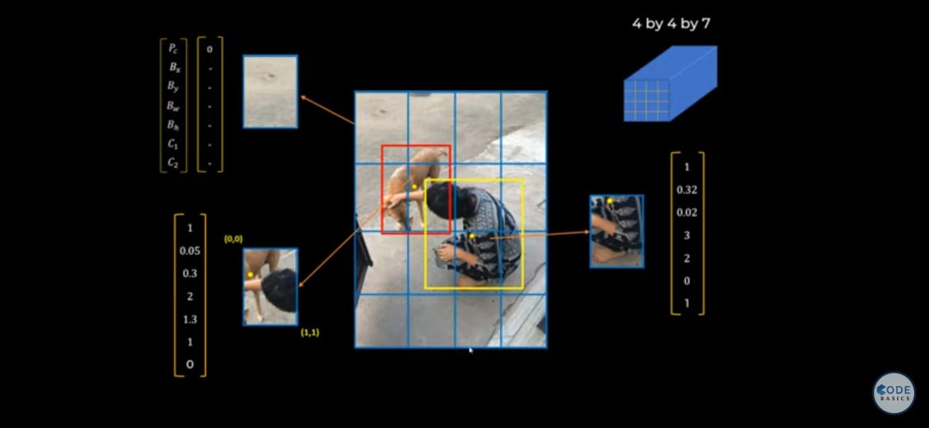
WORKING OF YOLO
step 1: Input Image: YOLO takes an image as input.
Step 2:Grid Division: The image is divided into a grid of cells of size 13x13 0r 26x26, with each cell responsible for detecting objects within its boundaries. The grid size is determined by the input image size and the size of the network's last convolutional feature map.

Slide 31
Step 3: Feature Extraction: Each cell undergoes feature extraction through a pre-trained Convolutional Neural Network (CNN). This CNN has been trained on a large dataset to learn features relevant for object detection. The choice of the network architecture often taken from established models like ResNeXt or Darknet.
Step 4:Objectness Score: YOLO predicts an objectness score for each cell using a logistic regression function. This score determines the probability of an object being present in the cell.

Slide 32
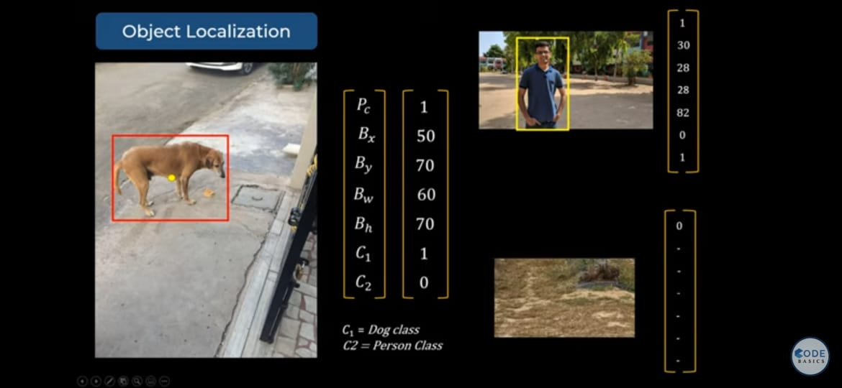
Step 5: Class Probability: For cells predicting an object, YOLO uses a softmax function to predict the object's class and its probability.

Slide 33
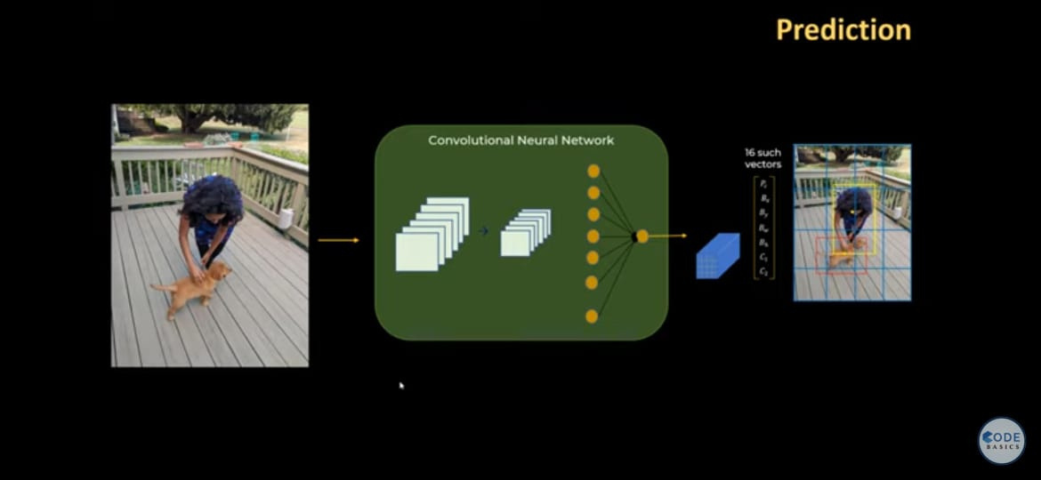
Step 6: Bounding Box Prediction: YOLO predicts the bounding box for each detected object in relation to the cell size. The bounding box is represented by its center coordinates, width, and height.

Slide 34
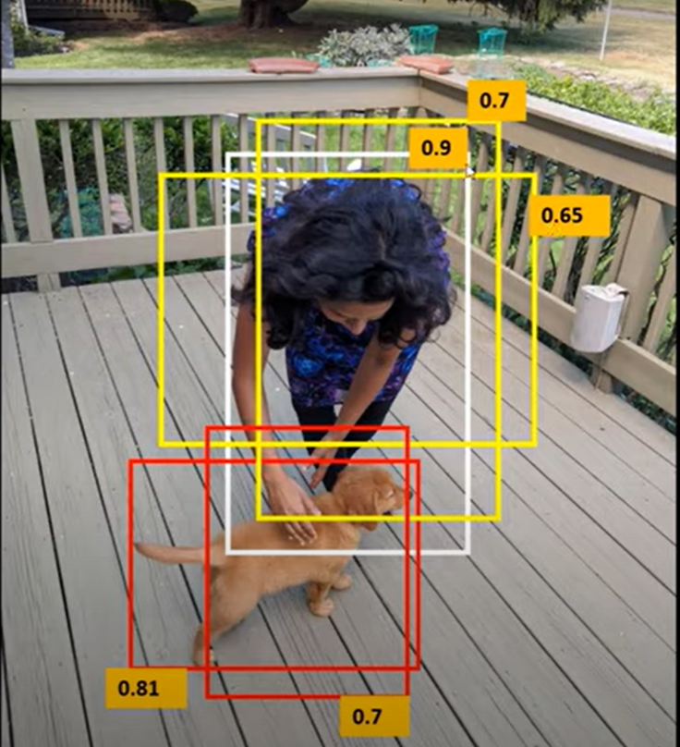
Step 7 : Non-Maximum Suppression (NMS): To enhance accuracy, YOLO performs NMS on predicted bounding boxes. NMS removes redundant boxes by eliminating overlapping boxes with lower confidence scores.

Slide 35
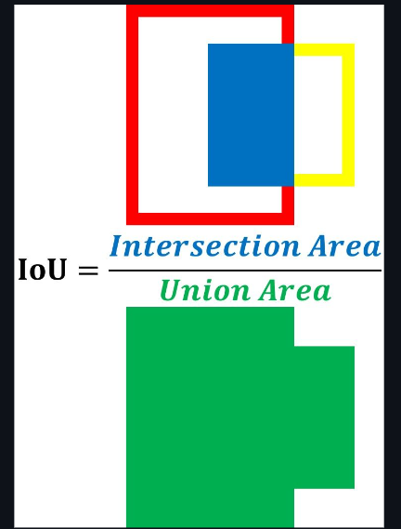
Step 8:Intersection Over Union(IOU): A better alternative is to use a quantitative measure to score how the ground-truth and predicted boxes match. This measure is the intersection over union (IoU). The IoU helps to know if a region has an object or not.

Slide 36
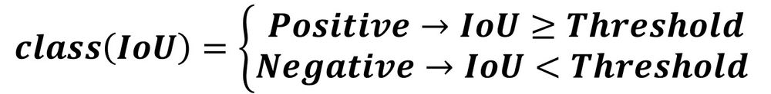
Intersection Over Union(IOU):As a summary, the IoU score measures how close is the predicted box to the ground-truth box. It ranges from 0.0 to 1.0 where 1.0 is the optimal result. When the IoU is greater than the threshold, then the box is classified as Positive as it surrounds an object. Otherwise, it is classified as Negative.

Slide 37
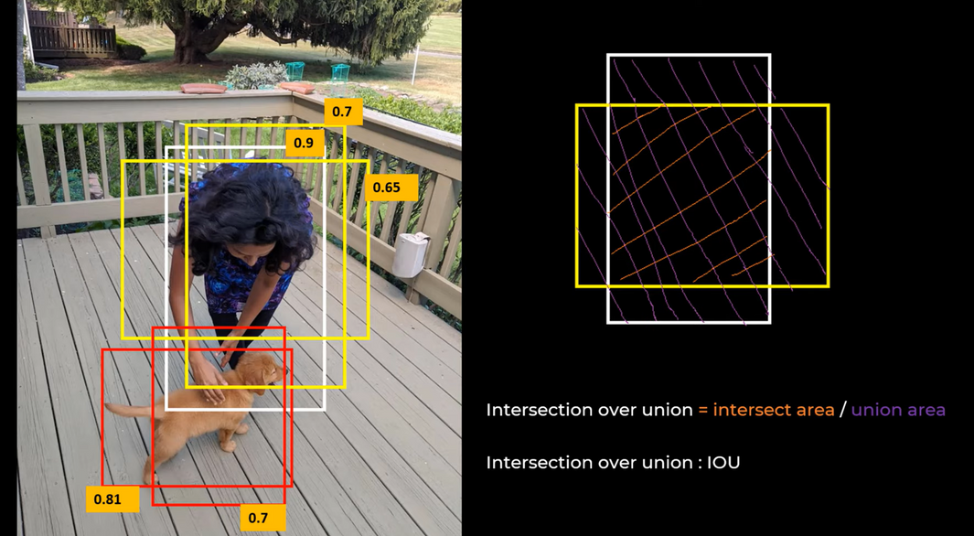
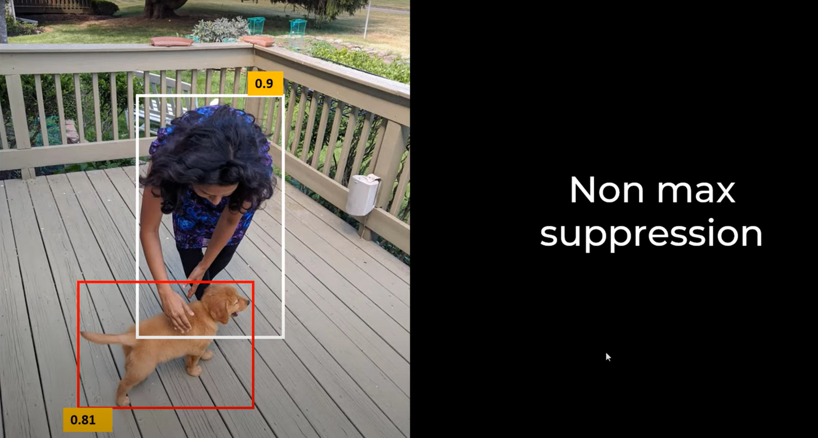
Intersection Over Union(IOU):Performing Non max Suppression

Slide 38
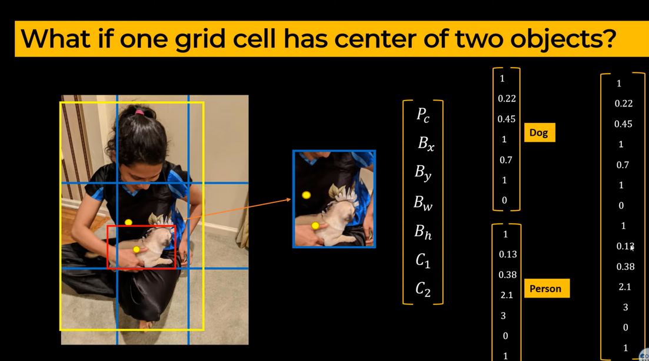
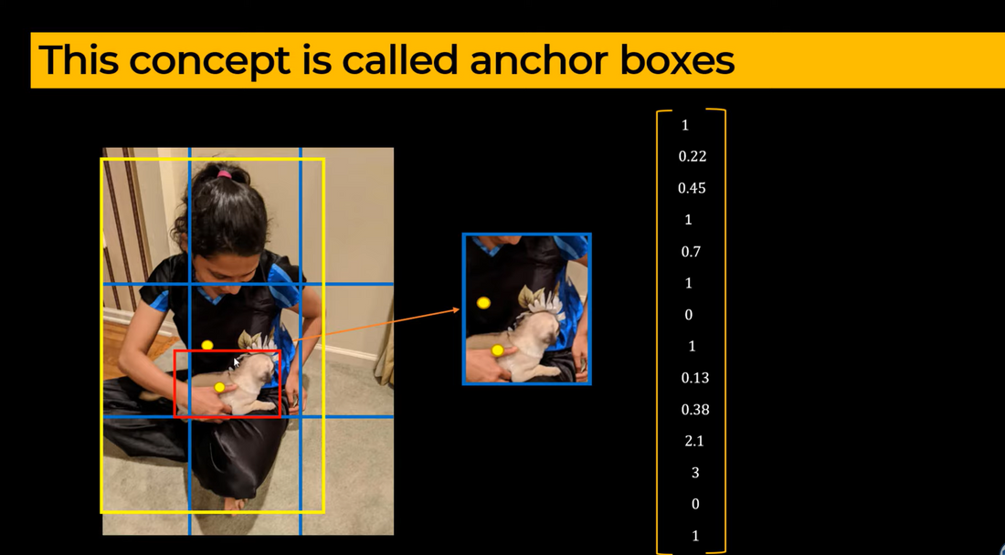
Another Issue in Object Detection: Anchor Boxes

Slide 39
Output: The final output of YOLOv8 is a list of bounding boxes, each associated with a class and a confidence score. These bounding boxes represent the detected objects in the input image.

Slide 40
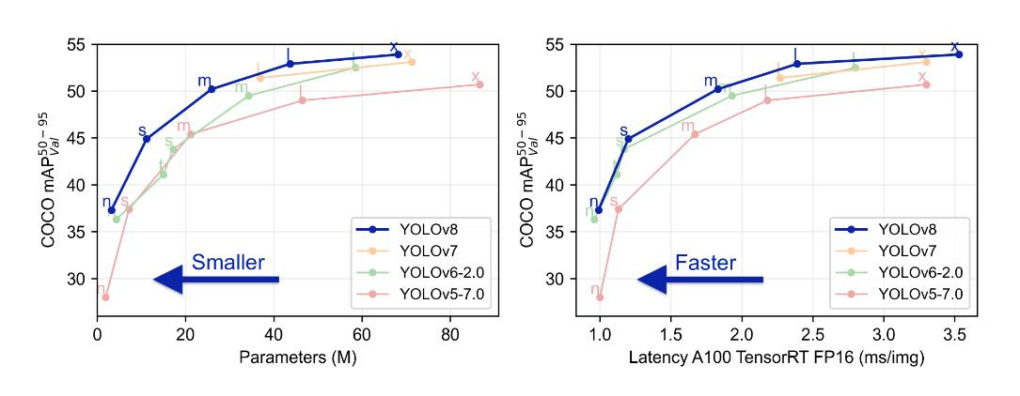
ANALYSIS OF YOLO V8
A) NUMBER OF PARAMETERS IN DIFFERENT VERSIONS OF YOLO ARCHITECTURE
B) INFERENCE SPEED FOR EACH YOLO VERSION

Slide 41
EVALUATION METRICS
mAP: mAP (mean Average Precision) measures the accuracy of an object detection model by computing the average precision (AP) for each class of object in the dataset and then taking the mean across all classes.
FLOPs: FLOPs estimate the number of floating-point arithmetic operations (such as addition and multiplication) that a model must perform during inference (i.e., when making predictions on new data).
Speed (fps): In deep learning, speed FPS (frames per second) is a metric used to measure the inference speed of a model. It represents the number of input frames that the model can process in one second and is often used to evaluate the real-time performance of a model.
params: In deep learning, "params" typically refers to the number of trainable parameters in a model. These parameters are the weights and biases of the neurons in the neural network, which are learned during training to minimize the loss function.
Size (pixels): In YOLO (You Only Look Once), "size (pixels)" typically refers to the input size of the images used to train the model.

Slide 42
SOME OF THE CRITICAL FEATURES OF YOLO V8 INCLUDE THE FOLLOWING:
When we compare the performance of different YOLO generations and model sizes in the COCO database, we want to compare different metrics.
Performance: Mean average precision (mAP)
Speed: Speed of the inference (In fps)
Compute (cost): The size of the model in FLOPs and params

Slide 43
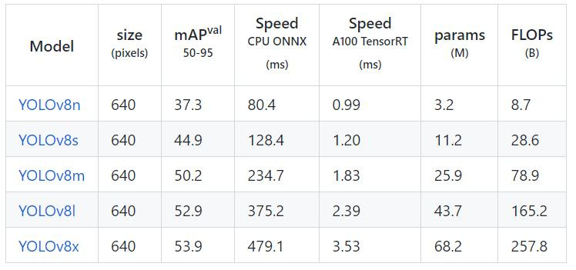
PERFORMANCE BENCHMARK FOR YOLOV8

Slide 44
RASPBERRY PI
Raspberry Pi is a series of small, affordable, single-board computers developed by the Raspberry Pi Foundation. Raspberry Pi's affordability, versatility, and ease of use make it a popular choice for a wide range of projects in education, DIY enthusiasts, and professional applications.
Raspberry Pi plays a significant role in democratizing edge computing by providing accessible hardware for experimentation, prototyping, and deployment of edge applications across various domains, including IoT, AI, robotics, and industrial automation.

Slide 45
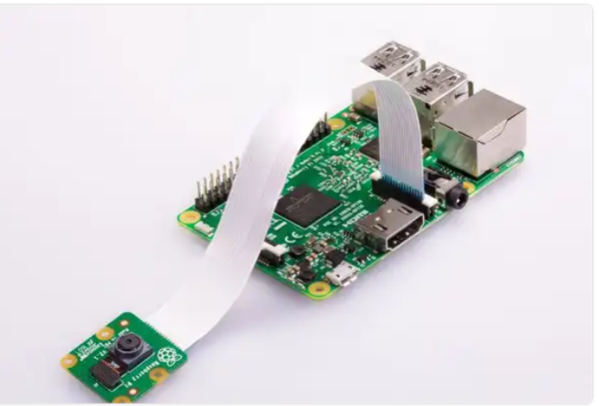
RASPBERRY PI
.
The Raspberry Pi is a small, versatile device on which you can deploy your computer vision models. you can use state-of-the-art YOLOv8 models on your Raspberry Pi.
Connected to a camera, you can use your Raspberry Pi as a fully-fledged edge inference device. Once you have downloaded your model to the device, an internet connection is not required, so you can use your Raspberry Pi wherever you have power.
The camera module is very popular in home security applications, and in wildlife camera traps.

Slide 46
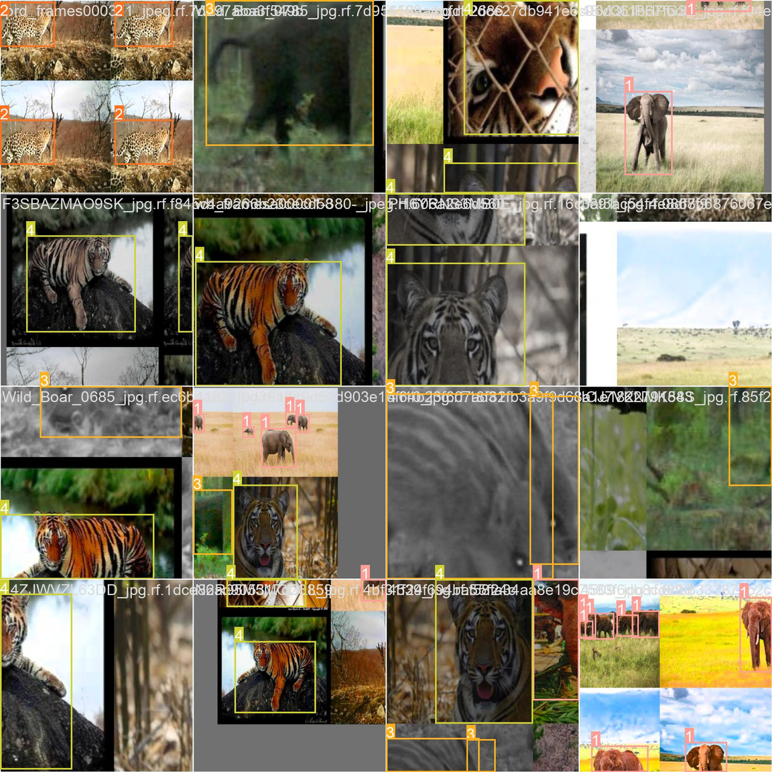
TRAINING BATCH IMAGES

Slide 47
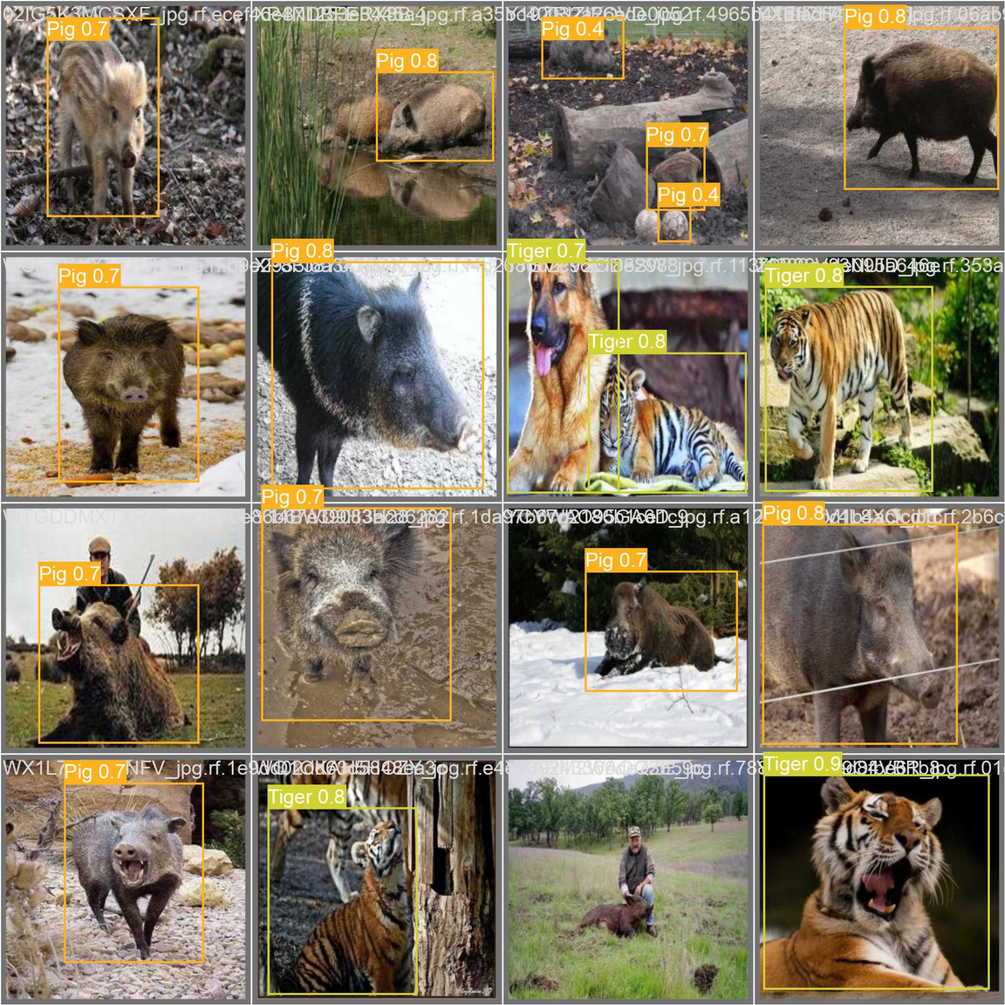
PREDICTIONS OF VALIDATION SET

Slide 48
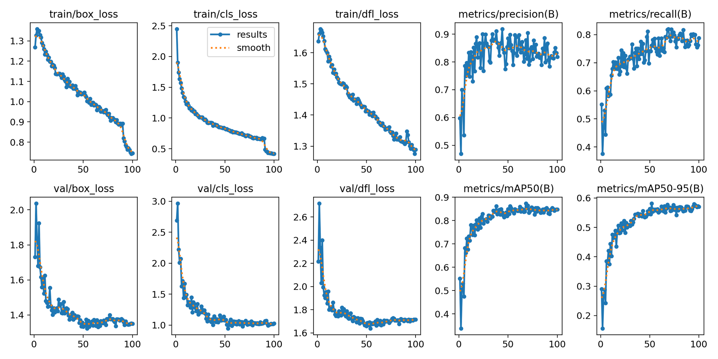
PERFORMANCE EVALUATION
X axis represents number of epochs
Y axis represent the loss value.

Slide 49
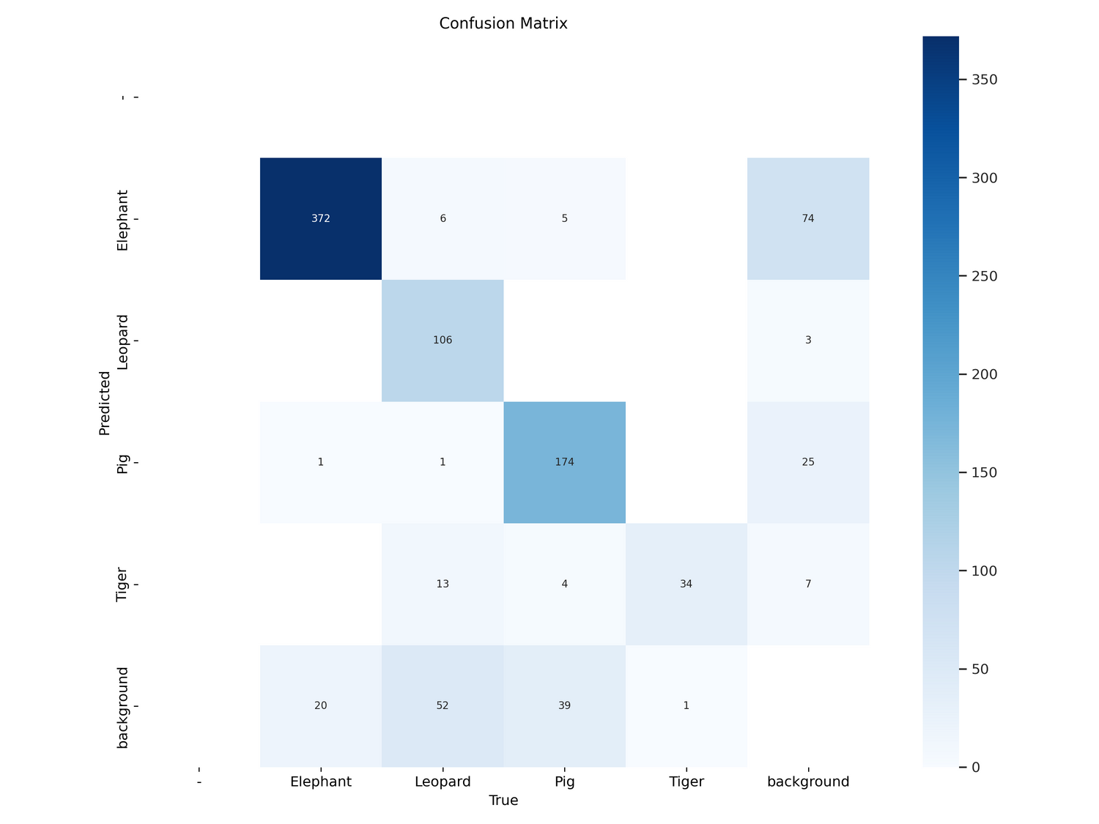
CONFUSION METRICS

Slide 50
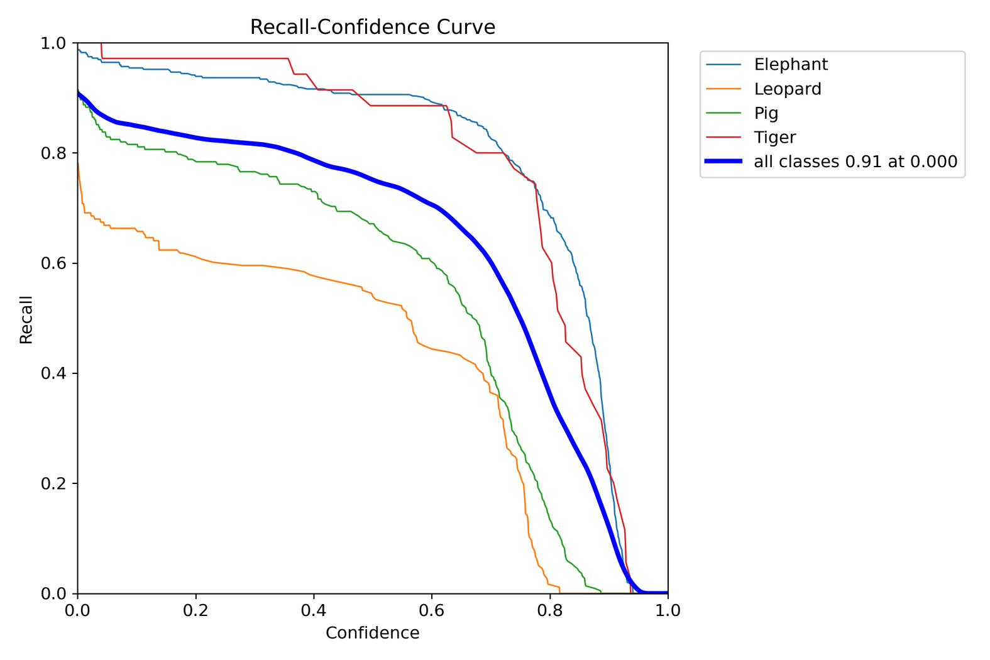
R - CURVE

Slide 51
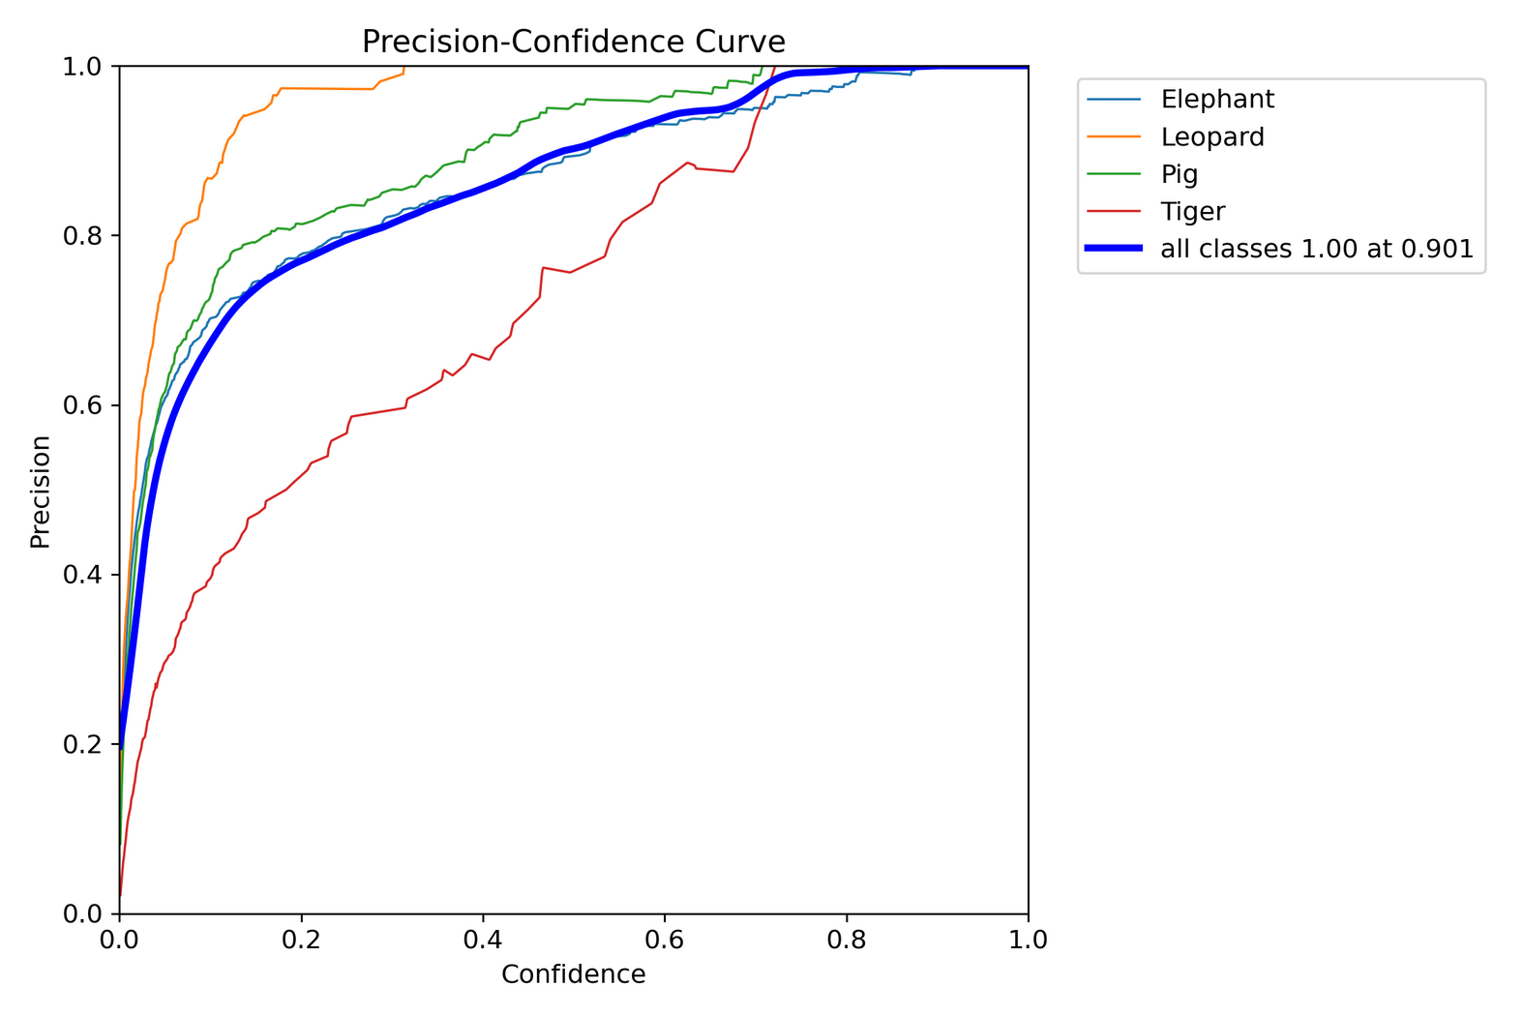
P - CURVE

Slide 52
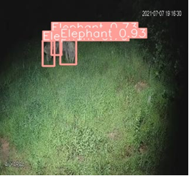
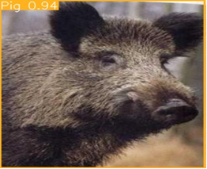
SOME PREDICTIONS
Fig 1:Elephant detected with 93% confidence
Fig 2:Pig detected with 94% confidence

Slide 53
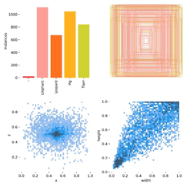
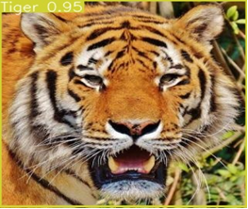
SOME PREDICTIONS
Instances and labels
Tiger detected with 95% confidence

Slide 54
CONCLUSION
Class-Wise Results (Below will only act as a sample)
i. Elephant: Precision: 88.5%, Recall: 90.6%, mAP: 95.1%.
ii. Leopard: Precision: 100%, Recall: 55.6%,mAP: 71.9%
iii. Pig: Precision: 95%, Recall: 68.2%, mAP: 83.8%
iv. Tiger: Precision: 75.9%, Recall: 90.1%, mAP: 94.2%
Overall mAp for YOLOv8m(medium) was 86% which much improved on model with COCO dataset which is 50.2%.
2. Efficiency Metrics:
Speed: Preprocessing Time: 0.8ms,
Inference Time: 4.7ms,
Post-processing Time: 3.1ms.
The model demonstrated efficient processing times, making it suitable for real-time applications.

Slide 55
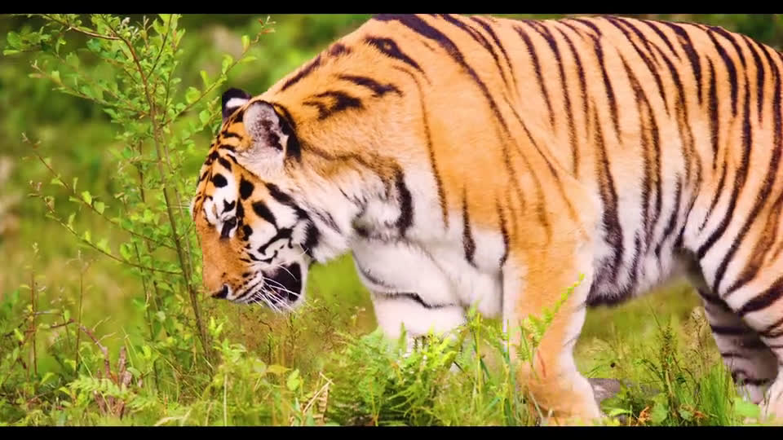
REAL TIME VIDEO DETECTION

Slide 56
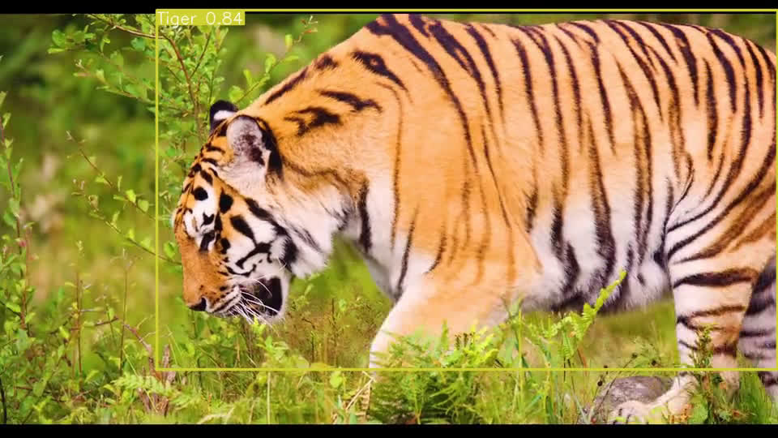
REAL TIME VIDEO DETECTION OUTPUT

Slide 57
REFERENCES
Base paper
https://papers.ssrn.com/sol3/papers.cfm?abstract_id=3867275
Coco dataset
https://docs.ultralytics.com/datasets/detect/coco/
Roboflow
https://roboflow.com/
Image Annotation
https://research.aimultiple.com/image-annotation/
YOLO models
https://learnopencv.com/ultralytics-yolov8/
YOLOv8 models
https://blog.roboflow.com/whats-new-in-yolov8/
https://stackoverflow.com/questions/75809415/yolo-v8-result-grap

Slide 58
Internship (AWS Graduate Data Engineering Virtual Internship)
Popular AWS Services for Data Engineering In 2022
Here is a list data engineering services offered by AWS:
Data Storage: AWS S3
Analyzing Streaming Data in real time- Amazon Kinesis
Tool for ETL Pipelines- AWS Glue
Analyzing Log metrics- AWS Cloudwatch
Data Warehousing- Amazon Redshift
Control Access to AWS Services- AWS IAM
Serverless Computing- AWS Lambda
Large Scale Data Processing- Amazon EMR
RDBMS System- Amazon DynamoDB
Querying Data- Amazon Athena

Slide 59
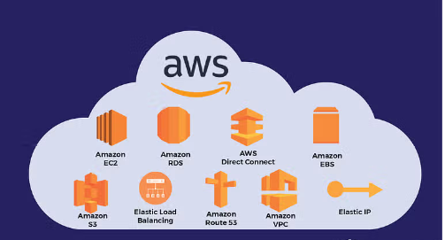

Slide 60
Internship Ai-ML ,Google for Developers
Objective of activity done: Databases, Cloud Architecture and Introduction to Auto Scaling and Monitoring.
Detailed Report:
Provide an overview of different Business problems solved with machine learning.
Basic process of how the machine learning works on real time projects.
Basic Description of Machine learning tools that are in basic projects.
Challenges in Machine Learning Challenges.
Introduction about AMAZON SageMaker.
Problem solving that faced with machine learning.
Overview of Process, Tools and problems of Machine Learning

Slide 61
THANK YOU!

